Slide 1
“Supported Employment And Optimization Of Services In The Labor Policy In Georgia”
Survey of Employment Opportunities for
People with Disabilities
Presentation

Slide 2
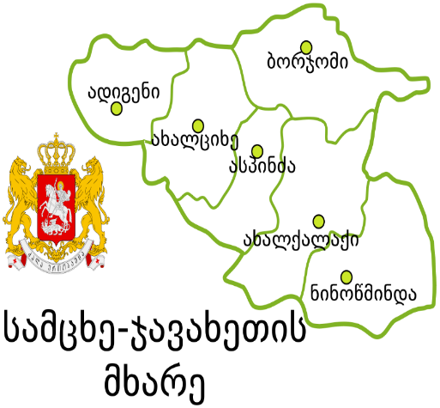
Mtskheta
Dusheti
Gori
Khashuri
Akhaltsikhe
Borjomi
The Goal of the Survey:
A study of the existing opportunities in terms of employment of persons with disabilities at the national and regional levels
in Shida Kartli, Samtskhe-Javakheti, Mtskheta Mataneti regions.
Objectives of the Survey:
Obtain and study public information and legal framework as well as various surveys on the employment of people with disabilities.
Conduct focus interviews with people with disabilities who are able to work and explore their attitudes and employment opportunities.
Conduct a quantitative survey in Shida Kartli, Samtskhe-Javakheti and Mtskheta-Mtianeti regions to study their labor skills of and to represent their daily life.
Prepare recommendations and conduct an advocacy campaign at a national and regional level.

Slide 3
Analysis of Survey
Qualitative
Quantitative
Study of legal framework on regional and national level;
Request public information;
Study of documents and secondary analysis.
Table Survey,
October-November 2021
Discussion Plan of Focus Group,
December 1-6,
2021
Quantitative Survey
22.12.2021-30.12.2021

Slide 4
In 1995, Georgia has adopted a law on social protection of persons with disabilities
On December 26, 2013, the Convention on the Rights of Persons with Disabilities was ratified
What has changed since 2014?
From December 31, 2019, the state program for 2020 has started, which provides subsidizing the salaries of beneficiaries employed in new or existing vacancies in the amount of 50%, 560 GEL for 4 calendar months.
Name of the service | 2018 | 2019
Training or retraining programs | 10 | 16
Employment forum | 10 | 19
Intermediary Service | 11 | 22
Supported Employment | 31 | 33
Internship | 13 | 16
Subsidizing | 24 | 2

Slide 5
Challenges of Employment of Persons with Disabilities:
Employment of PwD is unprofitable;
Minimal wage fails to meet daily needs;
Disordered infrastructure which doesn’t meet the standards;
The Civil Service Bureau does not have vacancies for people with disabilities, moreover, several employees were fired without receiving a salary;
State programs for employment and equality of persons with disabilities are created without involvement of PwD, experts and non-governmental organizations working on problems of persons with disabilities;
Most of the municipalities do not have information about the disabled people employed there, PwD requesting support, or PwD employees in the educational institutions.

Slide 6
Employment Rates by Municipalities as of November 30, 2021
Statistics of Recipients of State Aid by Regions and Municipalities
Municipality | Gori | Khashuri | Mtskheta | Dusheti | Akhaltsikhe | Borjomi
Number of Employees by Municipalities | 6 | 0 | 4 | 1 | information n/a | information n/a
Number of Employees in the Education Institutions | 9 | 4 | 10 | 0 | information n/a | information n/a
Region | Total | Male | Female
Shida Kartli | 9 594 | 6 024 | 3 570
Mtskheta-Mtianeti | 2 915 | 1 853 | 1 062
Samtskhe-Javakheti | 4 781 | 3 002 | 1 779
Municipality | Total | Male | Female
Gori | 4 379 | 2 777 | 1 602
Khashuri | 2 363 | 1 413 | 950
Mtskheta | 1 442 | 907 | 535
Dusheti | 818 | 527 | 291
Akhaltsikhe | 1 193 | 724 | 496
Borjomi | 1 003 | 685 | 328

Slide 7
Education
On February 21, 2018, Order # 16/N approved the rules for the introduction, development and monitoring of inclusive education and the mechanism for identification of students with special educational needs.
Region | SEN/PwD secondary school students
Abkhazia | 49
Adjara | 998
Guria | 429
Tbilisi | 3 685
Imereti | 1 388
Kakheti | 1 006
Mtskheta-Mtianeti | 263
Racha-Lechkhumi and Kvemo Svaneti | 63
Samegrelo-Zemo Svaneti | 752
Samtskhe-Javakheti | 283
Kvemo Kartli | 1 040
Shida Kartli | 634
Total | 10 590
Regin | SEN/PwD high school students
Adjara | 26
Guria | 5
Tbilisi | 89
Imereti | 12
Kakheti | 12
Mtskheta-mtianeti | 1
Racha-Lechkhumi and Kvemo Svaneti | 3
Samegrelo-Zemo Svaneti | 14
Samtskhe-Javakheti | 3
Kvemo Kartli | 10
Shida Kartli | 4
Total | 179

Slide 8
Table Survey Recommendations:
The state should ensure the preparation of a packages of amendments to the Tax Code, which stipulates the introduction of tax benefits in case of employment of persons with disabilities in the private sector.
Review the costs and types of medical insurance services for persons with disabilities and create an insurance packages tailored to their needs;
Infrastructure should be regulated at the municipal level and private companies should have an obligation to adapted space for the disabled persons.
Include Braille textbooks in educational institutions and hire teachers fluent in sign language.
Active involvement and close consultation with persons with disabilities of all ages through their human rights organizations to be mandatory.

Slide 9
Focus Group
People with disabilities are not aware of their rights, which makes this group even more vulnerable, and ignorance of their rights causes a number of problems.
State insurance does not cover the needs of people with disabilities and most rehabilitation centers do not meet their needs, thus they have to travel to Tbilisi, which is an additional cost.
Lack of day centers for people with disabilities.
Non-standard infrastructure and inadequate educational institutions.
Discriminatory treatment of persons with disabilities in the society and the workplace.
Lack of social enterprises.
Lack of small business grants for people with disabilities.
Incomplete work and incompetence of the State Employment Promotion Agency.
Six Municipalities:
Gori
Khashuri
Akhaltsikhe
Borjomi
Mtskheta
Dusheti
Four Focus Discussions
24 PwD
Parents of 8 PwD
Non-Governmental organizations working on the problems of PwD

Slide 10
Focus Group Quotes:
“We are not asking for much, merely for the municipality to allocate a small sum of money, or you, the non-governmental sector, to buy just one sewing machine and the young person will be able to work with his hands to create and sell his work. There are often examples of Tserovani social enterprise in the media stating that they started working as a social enterprise for 700 or 800 GEL and today they have more than 15 beneficiaries. Is not it possible for such social enterprises to be financed with small grants? At least to educate us on how to write projects or business plans to help us find these opportunities (parent of a child with disabilities) ... It would be much easier if the parents and children (disabled child) could work in an enterprise together, since often our children cannot work independently and we would help them along the way. Such examples are quite frequent in Europe and have proven to be quite effective. “(focus group #4)
It means - civil society (NGO- non-governmental organization)
it means - young people 18+
“The state is too late for supporting employment of people with disabilities, too many barriers have been created, but I hope that in the future it will be corrected, and that people with disabilities will be employed and engaged in various activities... The shortcoming stem from both the state and the society, although initially it is necessary to change the attitude of the society towards people with disabilities, in order to change the attitude of the state, it is necessary to raise awareness about the rights of people with disabilities. Blaming only the government would not be fair, I believe everyone must work together on this issue, including the municipality, private sector and the society.” (focus group#4)

Slide 11
Focus Group Quotes:
Persons with disabilities named the following professions for the job opportunities:
Beauty Salon staff,
Teacher’s Assistant,
Carpenter, working with wood and assembling furniture,
Driver
Knitting / sewing,
Jewellery manufacturing,
Sales consultant,
Involvement in agriculture,
Cook,
Photography,
Office work and working with computer programs
Call centre work and etc.
“Announced vacancies are often incompatible with our capabilities, as we receive info about positions of a waiter or a construction worker. Such types of vacancies do not suit me as I have a physical disability and it is difficult for me to walk. Though I can work with a computer, I know office software, I have worked in a call centre and this type of work is much easier for me. I attended the forum set up by Worknet, but it was complete formality, I could not get a job for the existing vacancies, or the position where I was interested was already occupied.” (focus group #3)

Slide 12
Focus Group Recommendations:
Adapting the environment for the use by the persons with disabilities is a prerequisite for all other initiatives.
The employment rate of persons with disabilities in the private sector should be increased
Social workers and people with disabilities should be involved in the development of programs in the municipalities.
Sharing experience of other counties.
Effective steps should be taken for the socialization and integration of persons with disabilities into the society.
Establish social enterprises with the financial support of municipalities.
Develop various educational programs for people with disabilities that will facilitate their employment in the labor market.
In order to integrate people with disabilities into the society, they need to be able to leave their homes and present their capabilities.
Day centers should be opened in all municipalities.
Increase capacity of day centers by financial and other support.

Slide 13
8
Councils of persons with disabilities that formally exist in municipalities have to become effective.
Regular or one of events should be organized to increase the involvement of disabled people into the community.
Create mini-grant programs to support the employment of the disabled community.
Create opportunities for internships
Employ persons with disabilities in social enterprises and / or allocate grants to create them.
Vacancies should have instructions on whether people with disabilities can be employed.
The civil and state sector to increase opportunities to acquire formal and informal education of PwD.
Day centers to remove limits and allow 18-29 year old beneficiaries.
Create initiative groups by people with disabilities who would start working at the level of the City Council and the City Hall.
The municipalities should allocate space for set up of social enterprises.

Slide 14
The state should develop a strategy for the employment of persons with disabilities and prepare a package of legislative changes to encourage their employment.
Persons with disabilities, or their family members, to receive free consulting services to prepare entrepreneurial ideas.
The pension and benefits package to be determined according to individual needs and assessments.
Increase the pension of people with disabilities to the subsistence level.

Slide 15
რაოდენობრივი კვლევა
22.12.2021-30.12.2021
ექვსი სამიზნე მუნიციპალიტეტი
გარემო პირობების შესწავლა
დასაქმების შესაძლებლობები და სამუშაო უნარები
შშმ პირთა ქცევა შრომის ბაზარზე
შშმ პირთა განათლება
დემოგრაფიული მონაცემები
150-ზე მეტი რესპოდენტი

Slide 16
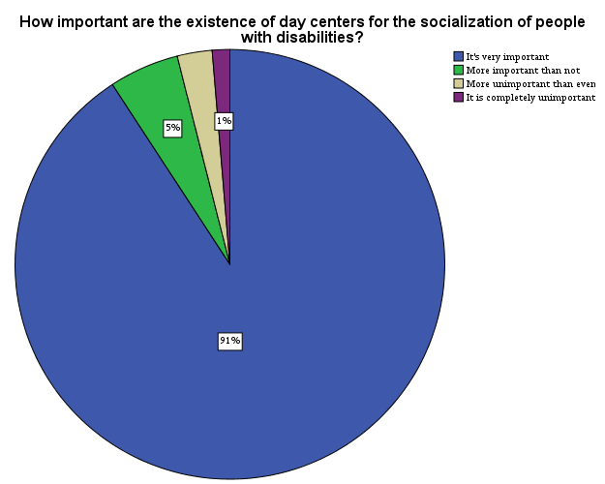

Slide 17
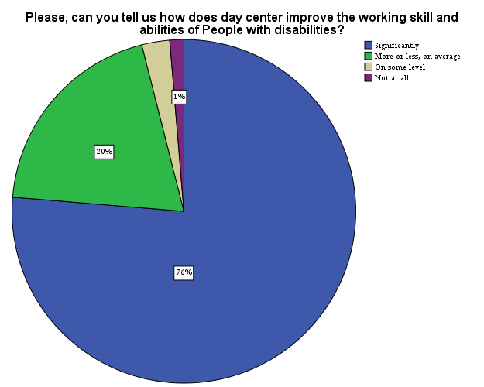
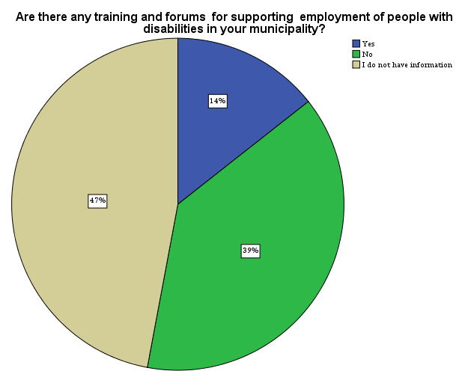
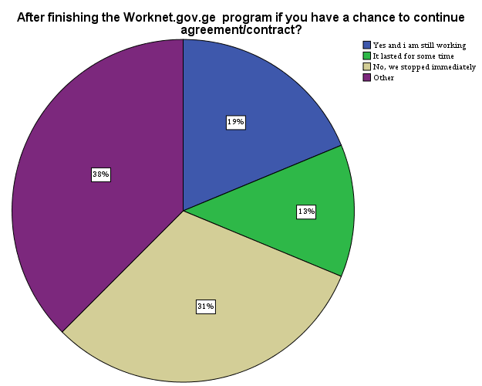

Slide 19
 |  | ეკონომიკური სტატუსი
 |  | დასაქმებული | უმუშევარი | შრომის უუნარო | პენსიონერი | სეზონურად დასაქმებული | დიასახლისი | დაქირავებული მუშა
 |  | Table N % | Table N % | Table N % | Table N % | Table N % | Table N % | Table N %
თუ იყო ხელშემშლელი ფაქტორი თქვენი დასაქმებისთვის? | არაადაპტირებული გარემო | 5% | 12% | 0% | 1% | 1% | 1% | 0%
 | შშმ სტატუსი | 3% | 16% | 2% | 2% | 0% | 1% | 0%
 | საზოგადოების/დამსაქმებლის დამოკიდებულება | 1% | 4% | 1% | 0% | 1% | 1% | 0%
 | ტრანსპორტის პრობლემა | 2% | 0% | 0% | 0% | 0% | 0% | 0%
 | მესაჭიროება დამხმარე (შვილის დასატოვებლად/ასისტენტი) | 0% | 5% | 1% | 0% | 0% | 3% | 0%
 | სამუშაო ადგილების არ არსებობა | 2% | 5% | 1% | 5% | 1% | 1% | 1%
 | არ იყო ხელშემშლელი არაფერი | 6% | 1% | 2% | 7% | 0% | 1% | 0%
 | პანდემია | 1% | 0% | 0% | 0% | 1% | 0% | 0%
 | სხვა | 3% | 5% | 1% | 3% | 1% | 1% | 0%

Slide 20
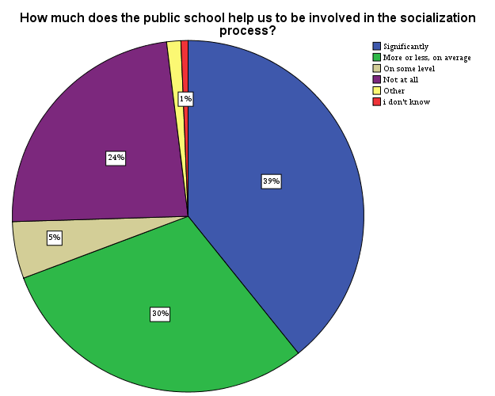

Slide 21
 |  |  |  | რომელ მუნიციპალიტეტში ცხოვრობთ?
 |  |  |  | გორი | ხაშური | ბორჯომი | ახალციხე | მცხეთა | დუშეთი | სხვა
 |  |  |  | Table N % | Table N % | Table N % | Table N % | Table N % | Table N % | Table N %
გაქვთ თუ არა წვდომა პროფესიულ გადამზადებაზე? | დიახ | ეკონომიკური სტატუსი | დასაქმებული | 6.5% | 1.3% | 0.0% | 0.0% | 0.0% | .7% | 1.3%
 |  |  | უმუშევარი | 7.2% | 0.0% | 0.0% | .7% | 0.0% | 0.0% | 0.0%
 |  |  | შრომის უუნარო | 0.0% | 0.0% | 0.0% | 0.0% | 0.0% | 0.0% | 0.0%
 |  |  | პენსიონერი | .7% | 0.0% | 0.0% | 0.0% | 0.0% | 0.0% | 0.0%
 |  |  | სეზონურად დასაქმებული | 0.0% | 0.0% | 0.0% | .7% | 0.0% | 0.0% | 0.0%
 |  |  | დიასახლისი | 0.0% | 0.0% | 0.0% | .7% | 0.0% | 0.0% | 0.0%
 |  |  | დაქირავებული მუშა | 0.0% | 0.0% | 0.0% | 0.0% | 0.0% | 0.0% | .7%
 | არა | ეკონომიკური სტატუსი | დასაქმებული | 3.9% | 1.3% | 2.6% | 0.0% | 1.3% | 0.0% | 1.3%
 |  |  | უმუშევარი | 9.2% | 3.3% | 5.2% | 9.8% | 1.3% | 2.0% | 2.6%
 |  |  | შრომის უუნარო | 3.3% | 0.0% | 0.0% | 2.0% | .7% | .7% | 0.0%
 |  |  | პენსიონერი | 2.0% | .7% | .7% | .7% | 7.2% | 4.6% | 2.0%
 |  |  | სეზონურად დასაქმებული | 0.0% | 0.0% | .7% | 2.6% | 0.0% | 0.0% | 0.0%
 |  |  | დიასახლისი | 1.3% | 2.6% | .7% | 2.6% | 0.0% | 0.0% | 1.3%
 |  |  | დაქირავებული მუშა | 0.0% | 0.0% | 0.0% | 0.0% | 0.0% | 0.0% | 0.0%

Slide 22
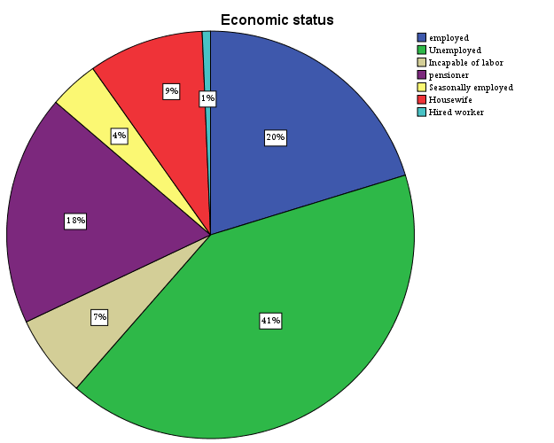
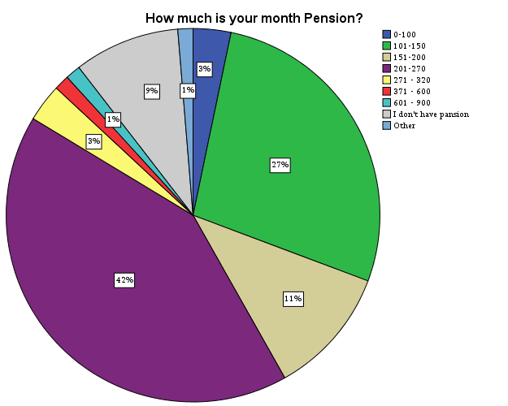

Slide 23
Quantitative survey recommendations:
Adapt the environmental regulations in the municipality and involve people with disabilities and relevant experts in the development or evaluation;
Public transport should be adapted and accessible for persons with disabilities;
The principles of equality and human rights for persons with disabilities should be protected and the anti-discrimination law should become effective;
Introduce tax incentives for companies employing people with disabilities
Establish a unified government database on persons with disabilities, which will include their contact information, as well as information on working capacity and skills, which will facilitate communication between the employer and the job seeker;
Fill in the job descriptions with a field indicating whether the work environment is adapted for the disabled person;

Slide 24
Increase pension to the subsistence level
Small social entrepreneurial co-financing to be provided at the municipal or state level;
Educational spaces should be adapted to the needs Of PwD and the budget should include expenditures for relevant changes;
Increase support for rehabilitation programs for persons with disabilities;
Open Day Centers for disabled persons
Municipalities should have statistical and contact data of persons with disabilities;
Facilitate awareness raising of people with disabilities about existing services, programs, funding, grants and opportunities;
Municipal councils of persons with disabilities become capable and can actually be involved in decision-making processes.

Slide 25
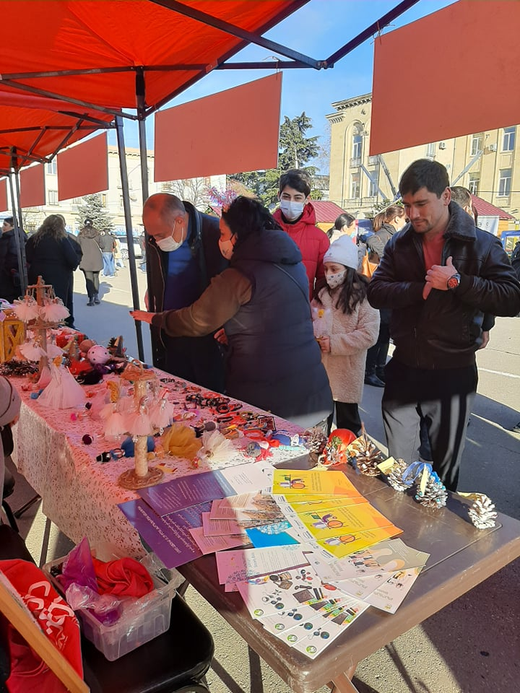
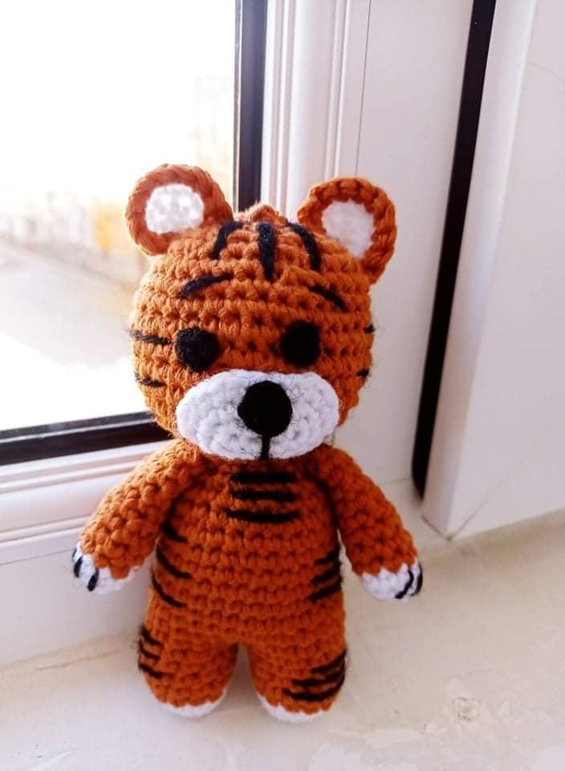
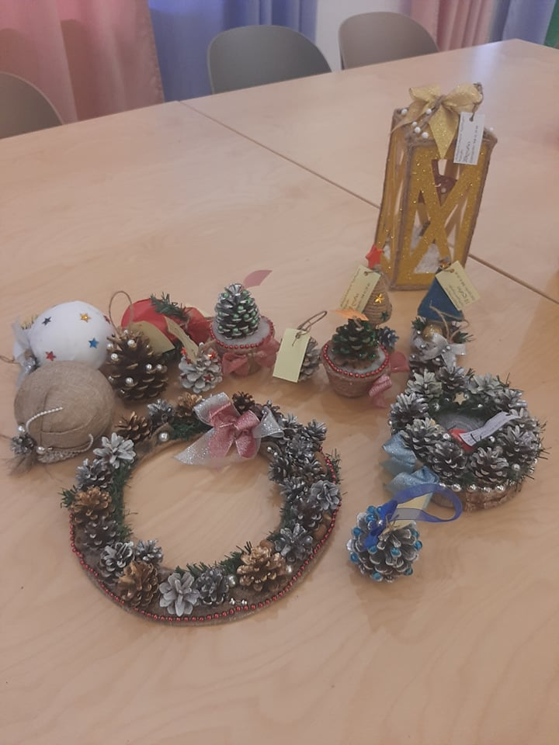
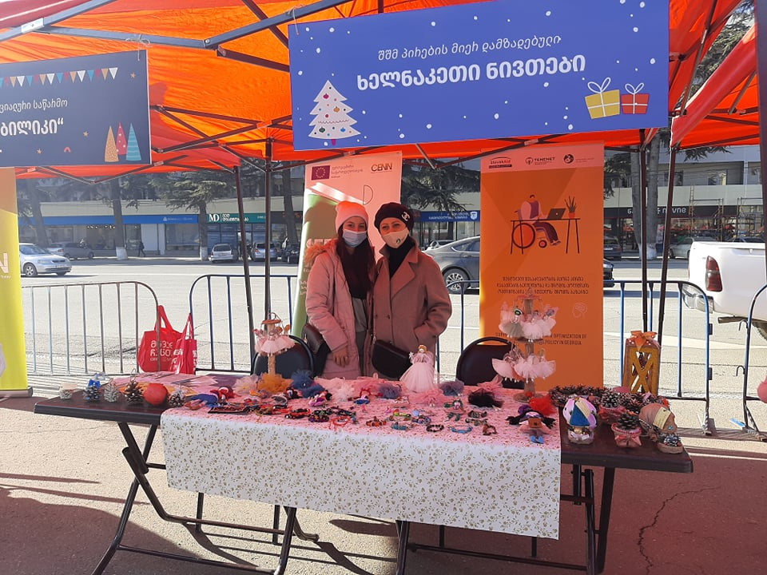
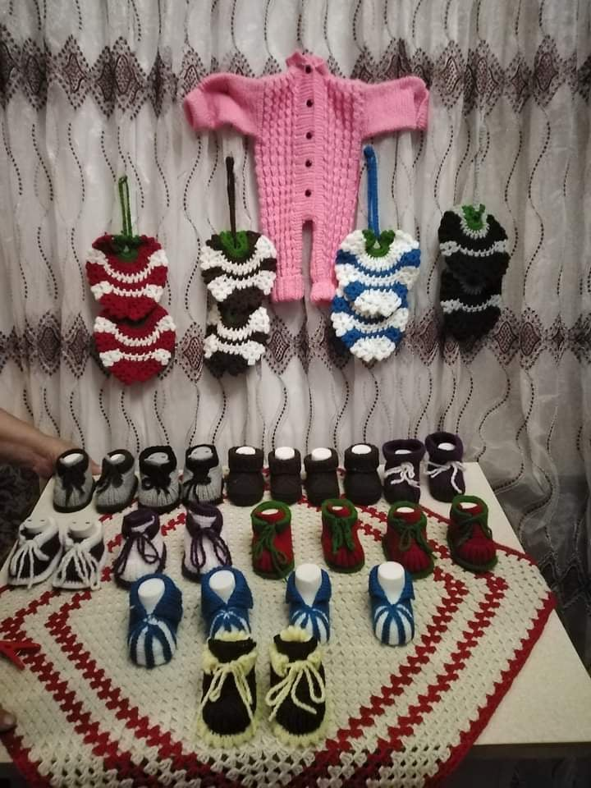
Entrepreneurship promotion for people with disabilities.
New Year exhibition-sale in Gori, December 30, 2022.
Organized by CENN

Slide 26
Thank You for Attention!

